Slide 1




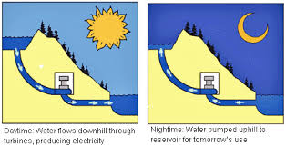


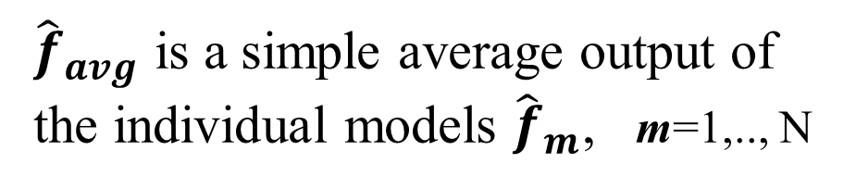


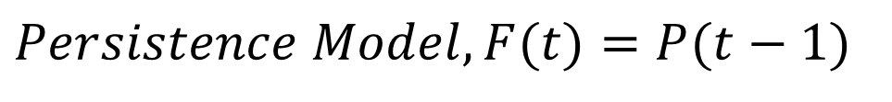
Photovoltaic Solar Power Forecasting
Mohamed Abuella, Student Member, IEEE, Badrul Chowdhury, Senior Member, IEEE
Department of Electrical and Computer Engineering
Energy Production & Infrastructure Centre (EPIC)
University of North Carolina at Charlotte, Charlotte, NC 28223-0001
1. Objectives
4. Methodology
5.3. Results and Evaluation
Using statistical and machine learning techniques to forecast the PV solar power, which can be implemented for:
Managing the economic dispatch, unit commitment, and trading of PV solar power generations with other conventional generations;
Using with situational awareness tools to manage the ramp limitation; Optimal energy management of energy storage systems;
Voltage regulator settings on feeders with PV distributed generation.
4.1. Individual Forecasting Models
Multiple Linear Regression (MLR) Analysis, Artificial Neural Networks (ANN), and Support Vector Regression (SVR) are deployed for day-ahead forecasts of PV solar power.
Input Variables (weather forecasts)
2. Introduction
Training Dataset
(solar power and weather data)
Task:
PV Solar Power Forecasting
Learning Algorithm
(MLR / ANN / SVR)
Fig. 5: Illustrative graph of PV solar power forecasts and observations, for 2 days
2.1. Motivation
Why do we need PV solar power forecasts?
Output Variable
(PV solar power forecasts)
Table III
RMSE of Different Models and Combined Forecasts
Table IV
MBE of Different Models and Combined Forecasts
P_{Generation} = P_{Demand} + P_{Loss}
Fig. 3: Block diagram of PV solar power forecasting models
Month | RMSE
 | Persist. | MLR | ANN | SVR | Average | Ensemble
June | 0.1285 | 0.0745 | 0.0680 | 0.0726 | 0.0682 | 0.0675
July | 0.1166 | 0.0926 | 0.0865 | 0.0831 | 0.0890 | 0.0870
August | 0.1633 | 0.0864 | 0.0811 | 0.0793 | 0.0812 | 0.0782
September | 0.1343 | 0.0738 | 0.0724 | 0.0776 | 0.0704 | 0.0728
October | 0.1353 | 0.0723 | 0.0670 | 0.0648 | 0.0664 | 0.0637
November | 0.1542 | 0.0793 | 0.0665 | 0.0679 | 0.0672 | 0.0676
December | 0.1183 | 0.0618 | 0.0542 | 0.0604 | 0.0536 | 0.0529
January | 0.1235 | 0.0705 | 0.0526 | 0.0552 | 0.0544 | 0.0514
February | 0.1307 | 0.0874 | 0.0704 | 0.0749 | 0.0768 | 0.0715
March | 0.1511 | 0.0855 | 0.0805 | 0.0832 | 0.0821 | 0.0821
April | 0.1320 | 0.0748 | 0.0637 | 0.0648 | 0.0665 | 0.0651
May | 0.1208 | 0.0571 | 0.0545 | 0.0566 | 0.0538 | 0.0552
Avg. RMSEs | 0.1341 | 0.0763 | 0.0681 | 0.0700 | 0.0691 | 0.0679
Std. Dev. RMSE | 0.0143 | 0.0101 | 0.0105 | 0.0094 | 0.0111 | 0.0108
Month | Mean Bias Error (MBE)
 | Persist. | MLR | ANN | SVR | Average | Ensemble
June | 2.5491 | -4.5496 | -4.4558 | -2.0429 | -3.6827 | 1.1046
July | 1.0411 | -15.6600 | -9.7906 | -14.1870 | -13.2125 | -8.9158
August | 0.6451 | -1.0525 | -2.3990 | -7.1867 | -3.5461 | -0.7044
September | -0.3979 | -0.0871 | 1.5521 | -2.3912 | -0.3087 | 2.2635
October | 0.6528 | 3.1621 | -4.7463 | -5.0227 | -2.2023 | -1.8820
November | -0.2226 | 9.0623 | 0.8405 | -0.6515 | 3.0838 | 4.0624
December | 0.7103 | 6.9379 | -0.2760 | -5.1266 | 0.5118 | -1.6370
January | -1.0500 | -5.8772 | -4.1514 | -3.8977 | -4.6421 | -5.1558
February | -3.1838 | -1.6228 | -2.8414 | -4.3724 | -2.9455 | -1.3200
March | 3.1823 | 0.8454 | 3.5505 | -0.9198 | 1.1587 | 6.2255
April | 0.3142 | 5.0138 | -1.6179 | -4.1976 | -0.2672 | 0.6574
May | -3.4874 | 2.0297 | 2.1124 | -1.4953 | 0.8823 | 4.9605
Avg. Bias | 0.063 | -0.150 | -1.852 | -4.291 | -2.098 | -0.028
PV Solar Power Generations
are Too Variable
Coordination with Operating Reserves and Energy Storage
Systems
Reducing
Cost
and Pollution
4.2. Ensemble Forecasts
The ensemble learning (i.e., random forests (RF)) combines the available weather data and the PV solar power forecasts of the individual models, all blended together to obtain more accurate and robust day-ahead forecasts of PV solar power.
Individual PV Solar Power Forecasts
MLR
Ensemble Learning (RF) for Combining of Forecasts
Combined Forecasts
ANN
SVR
Weather Data
Fig. 1: Illustration of the motivation of PV solar power forecasts
Fig. 4: Diagram of combining the different forecasts
5. Case Study
3. Framework of
PV Solar Power Forecasting
In this study several forecasting models of solar power are implemented to generate various forecasts, and then those forecasts are combined by ensemble learning method, random forests (RF).
5.1. Data Description
Main Steps:
Data collection: Historical PV solar power observations and weather data
Data preparation: Data cleansing and selecting the most effective features
Forecasting models: Using parametric and nonparametric models
Ensemble forecasts: Combining various models
The solar PV power system is located in Australia. The weather forecasts data and the measured solar power data were recorded from April 2012 to May 2014. The weather forecasts from European Center for Medium-Range Weather Forecasts (ECMWF), which is a global numerical weather prediction (NWP) model.
Table I
Available weather data
Table II
Data partition into training and testing sets
Fig. 6: Monthly RMSEs for different models and combined forecasts
No. Vars. | Variable Name
1 | Cloud Water Content
2 | Cloud Ice Content
3 | Surface Pressure
4 | Relative Humidity
5 | Cloud Cover
6 | 10m- U Wind
7 | 10m- V Wind
No. Vars. | Variable Name
8 | 2-m Temperature
9 | Surface solar radiation down
10 | Surface thermal radiation down
11 | Top net solar radiation
12 | Total precipitation
13 | Heat Index
14 | Wind Speed
No. | Month | Year | Partition
1 | April | 2012 | Training Set
14 | May | 2013
15 | June | 2013 | Testing Set
26 | May | 2014
6. Conclusion
Data preparation steps are essential before building the forecasting model.
In terms of the accuracy and the bias of the forecasts, the ensemble is the best.
For the individual models, ANN model provides more accurate forecasts (i.e., lower RMSE).
The SVR model is the most robust model with stable performance (lower Std. Dev. of RMSEs).
The MLR model is the less biased model (lower MBE), among the individual models.
The performance is fluctuating and not consistent over the entire year.
The performance depends on the model training, selected features, and data quality.
In the clear sky hours, the models produce more accurate forecasts than cloudy hours.
The more accurate weather forecasts lead to more accurate solar power forecasts.
With additional historical data, the forecasting performance could be improved
5.2. Evaluation Metrics
$$RMSE=\sqrt{\frac{1}{n}\sum_{i=1}^{n}{({{P_{i}−F}_{i})}^{2}}}$$
(1)
$$MBE=\frac{1}{n}\sum_{i=1}^{n}{\left({P_{i}−F}_{i}\right)}$$
(2)
where F is the solar power forecast and P is the observed value of the solar power. F and P are normalized to the nominal installed capacity of the solar power system, n is the number of evaluated forecasts.
$$Persistence Model, F(t)=P(t−1)$$
(3)
$${\hat{f}}_{avg}=\frac{1}{N}\sum_{m=1}^{N}{{\hat{f}}_{m}}$$
(4)
${\hat{f}}_{avg}$ is a simple average output of the individual models ${\hat{f}}_{m}$, m=1,.., N
Fig. 2: Flowchart of PV solar power forecasting
The forecasts of the persistence model (3) and the combined forecasts by the simple average (4) are used as benchmarks for a comparison with other individual and ensemble forecasts of PV solar power.
Acknowledgement
The authors would like to acknowledge the support of Energy Production and Infrastructure Centre (EPIC) at UNC Charlotte.

